Slide 1
Grad Student/TA Meeting
Fall 2023

Slide 2
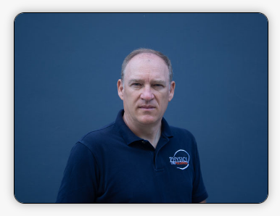
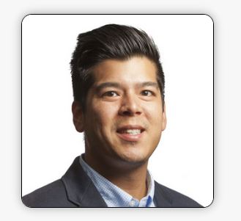
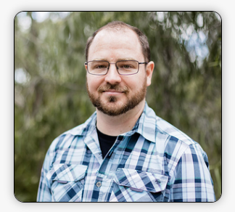
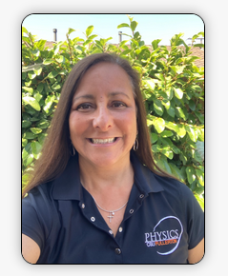
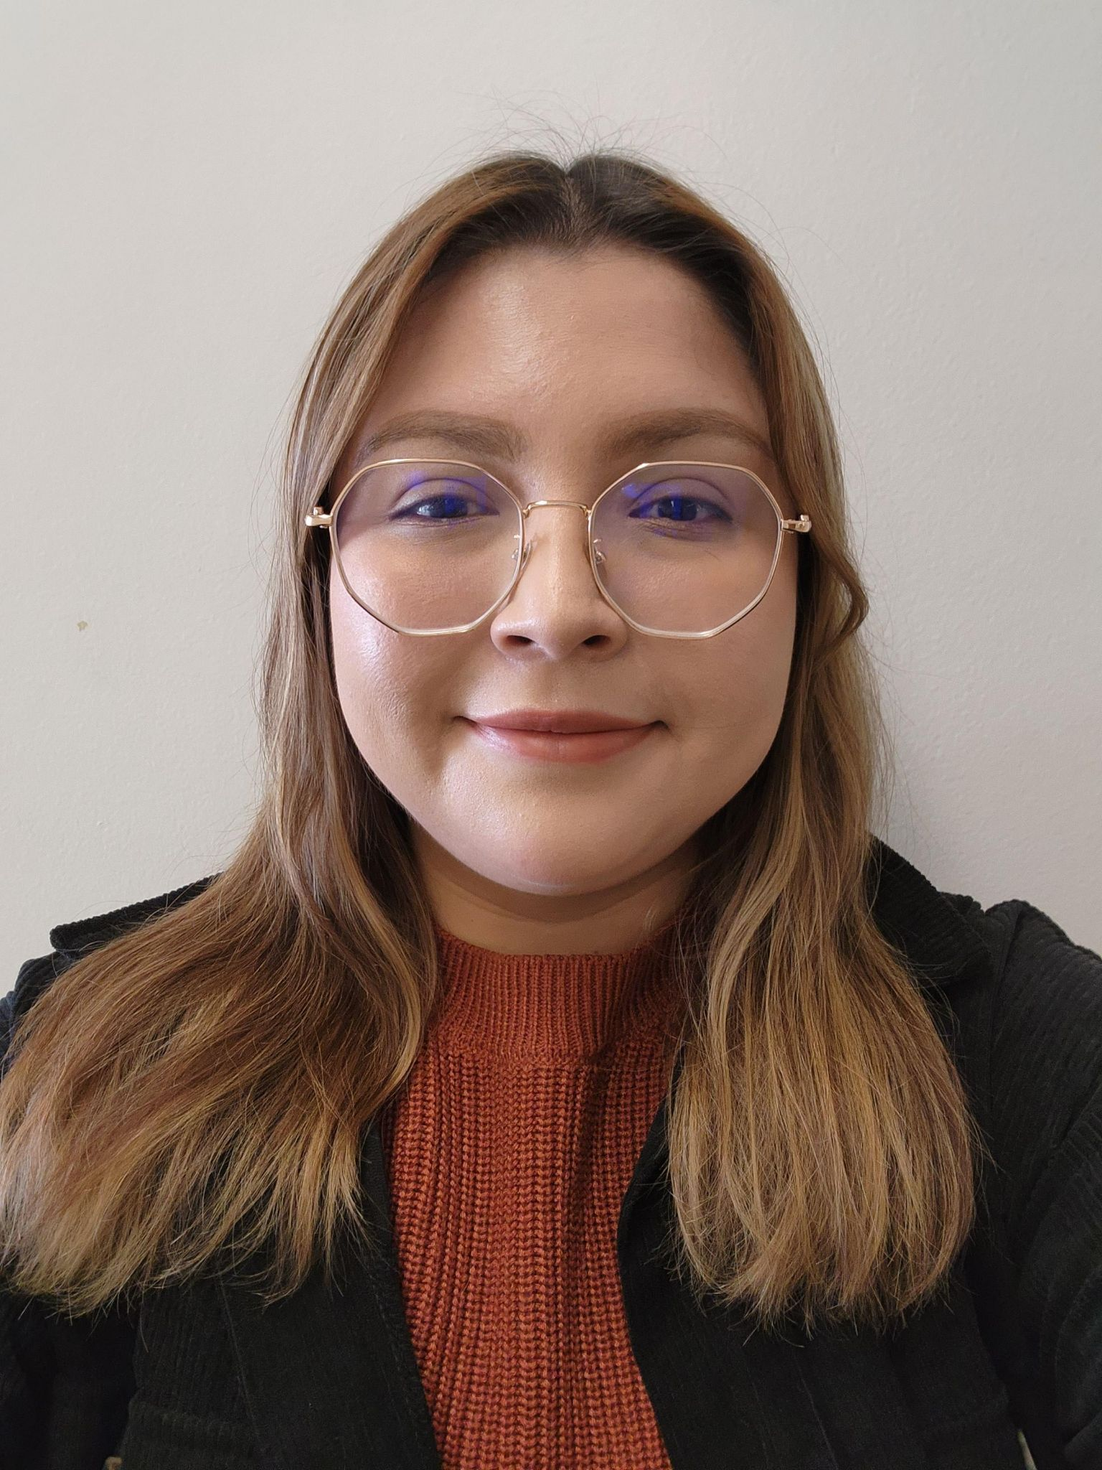
Dept Chair/ Grad Advisor:
Dr. Ionel Tifrea
Graduate Advisor:
Dr. Wylie Ahmed
Support Techs: Alex Gauf
Administrative
Support
Coordinators:
Support Techs: Edgar Lara
Veronica Traub
Danna Vasquez

Slide 3
Graduate Students
Information from Dr. Tifrea and Dr. Ahmed.

Slide 4
Returning TA Information

Slide 5
Website Reminders
Each labs webpage now links to subpages for each lab
You must direct your students to these labs, do not copy them to canvas since they are likely to be updated
You’ll find a “Lab Setup Guide” button linked on these pages
Refer to these to know what we should have out for you, let me know if something is missing
The logger pro files will now also be on these pages in a zip file
They should be able to run the file straight from the downloaded zip without issue

Slide 6
Teaching Reminders
You are responsible for preparing for your lab BEFORE your class
Do not wait until you are already in your class to look at the material
Show respect for your students
You should always be ready to go at least 10 minutes before the start of your class
No food in the labs, tell them to eat outside. Water/closed bottles are fine.

Slide 7
Emergency? Cancelling Class?
Emergency have you running late for 8am,1130am,3pm?
Message me on teams or text my work number, I can let them in and hold the class until you arrive
Notify your students through canvas announcements for all times
ALL LABS MUST BE HELD IN PERSON, email me, your advisor, Dr. Tifrea if there’s a reason you can’t make class
Cancelling for a scheduled reason? Find a cover
Utilize the @channel method in teams and @ the channel for the class you need covered, it’ll email anyone who doesn’t watch teams.
No one respond? @ the instructor channel.

Slide 8
Reminders - Starting/ending class
Do not let students into the room until you have at least walked the room
Enter the room before them and check the stations for anything left behind
Check for any dangerous conditions at stations
Once you’ve walked the room only let them in if you’re staying in
Once all your students are finished and before you leave walk the room again before leaving checking for anything left on the desks
Chargers
Phones
Laptops
etc

Slide 9
Reminders - Quizzes
Quizzes
Use to help differentiate groups (give credit where it’s due) and pressure students preread the next labs and come prepared.
Make the quiz what you’d like for your class, there are samples in the dropbox to use if you’d prefer that.
Please keep in mind it’s a lab quiz, not a lecture quiz.
Don’t directly use the samples, they have the answers out there.
Make it a real quiz.

Slide 10
Reminders - Running Lab
10-20 minutes lecture
Remember they’re all from different lecture classes so give them the basics, show them equipment
Lab work is to be completed in lab
They should complete the experiments, answer questions, complete everything and hand it in before they leave.
Remember you can tailor the labs as you need
Please note any tailoring you do in gdrive/teams/or email to me, this will help us improve the labs going forward.

Slide 11
Reminder all labs - Grading
You are teaching a 1 unit course, with a large weekly time commitment.

Slide 12
Astronomy 101 Instructors
Sun lab this semester will be a bit different
I’ll start the lab with you upstairs then we’ll all go down together and run the scopes
Astronomy EC nights
http://physics.fullerton.edu/events/astronomy/
Just point them to the page for the astr dates and times.
I’ll put a message out in teams the week before
Remember weather needs to be clear

Slide 13
Physics 211/225 Instructors
New process! Now a “Report” accompanies every lab. Overview
Checkpoints don’t need to be graded. YOU should still know the answer to them though.
Most questions turned into checkpoints. Remaining questions are main points.
Every lab now needs them to write a conclusion, no exceptions, grade this gently
Guide them toward concise technical conclusions, it won’t be easy
Grade based on
Quality of Data taken
Completing/answers to questions
Quality of conclusion
No tailoring your labs, do exactly as the report says to do.
Typos? Tell me I’ll update them in real time.

Slide 14
Lanschool and Deepfreeze Reminders
All rooms have lanschool which can be used to control and observe any student in the classroom
Smart boards are now also linked to lanschool, utilize that if you need to show something from your main desktop.
Deepfreeze is set to wipe and reset the PCs 10 mins after class ends
Everything they do will be lost
No way for you to stop it
Use this to make sure you class ends on time

Slide 15
Lab Tech Contact
Questions/issues/concerns?
You can text our work numbers now
657 278 3246 –Alex
657 278 7520 - Edgar
Teams
Use the instructors or general channels
Email
agauf@fullerton.edu
edlara@fullerton.edu

Slide 16
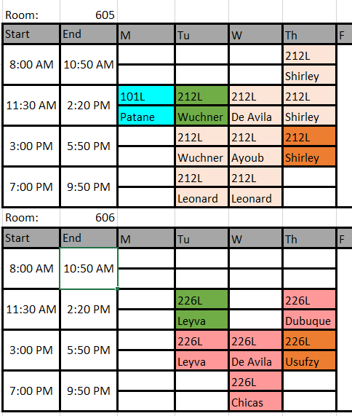
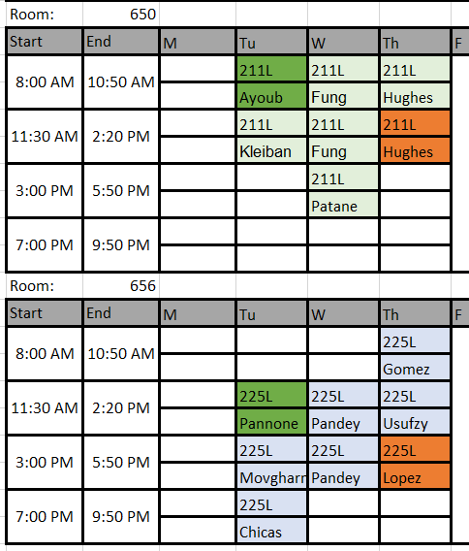

Slide 17
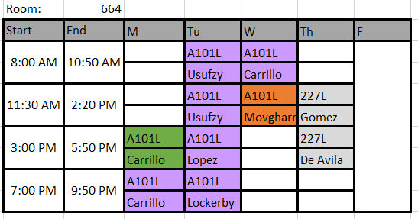

Slide 18
Questions?

Slide 19
New TA Information

Slide 20
Course materials
https://physics.fullerton.edu/
Department -> Lab schedules -> your lab
Your class must adhere to the online schedule and you must direct them to those online labs
Couldn’t do a lab for some reason? Skip it and continue with the schedule
The class instructor stations will have
Teams with an instructor account to contact me with
A File with a (possibly outdated) local copy of all labs.
a gdocs copy of each lab if you have any comments/notes to help improve them

Slide 21
Lab Rooms
Stations are numbered starting from front closest to door
1 to 6 front to back on door side
7 to 12 front to back on far side
Stations have labels
Each room has a “ready room” where all the equipment for the experiments is stored
Also where you’ll find tools, batteries, battery chargers, etc

Slide 22
Teams
Your new @Fullerton.edu address was invited
This will always be faster than email, but email is also fine
Setup your notification hours
Instructor stations in each lab have an account logged in, use them if you can’t get teams setup yourself.

Slide 23
Mandatory Training
Keep an eye out for an HRDI email for Unit 11 employee orientation.

Slide 24
“How do I run a lab?”

Slide 25
First Day
Introduce Yourself!
Syllabus
Post online!
Walkthrough important notes
Hard Copies
Meet your partner
Icebreaker?
Safety Document
Releases Instructor/Department from Liability

Slide 26
Preparation
Do the experiment!
Learn the difficult parts
Read the Lab
MINOR tailoring is fine
Familiarize yourself with the equipment
Labs will either be setup the Friday before or the Monday of.
Know your room
Dress the part
Make it at least somewhat obvious that you’re the instructor

Slide 27
Starting Class
Enter the class at least 10 minutes early WITHOUT STUDENTS
Walk the room once and look for anything that shouldn’t be there
Keep the students out until you’ll be in the room
You should not leave them in the room unattended for long periods of time
START ON TIME
The start time of your class is set by scheduling and is not negotiable

Slide 28
Lecture
10-20 minutes
Enough to prep them, not so much that you lose them
Explain Concepts of the Physics Behind the Experiment
Lecture may fall behind, check with your class
Explain the Experiment
What equipment will be used
How they will take data
What difficulties may there be
Your expectations for the report
Your data, plots, and answers to questions, skip part 6 etc.
Questions?

Slide 29
What they should do?
Complete the lab given
With your minor tailoring
Complete something for you to grade
Full lab report?
Fill in the blanks on worksheets?
Printed or online?
Fill in the blanks in the lab?
If you collect pdfs using canvas enable Turnitin checking
Make them do everything and collect it before they leave (No homework)
Can let them take home if they must, or for special labs, but avoid

Slide 30
Set Them Free
Restrict them to classroom PCs to reduce dishonesty
Walk around often
Be attentive to your class
Utilize lanschool
Watch for hands
Listen for mistakes
Help with setup
Try to make them do it themselves
Have multiple groups watch if everyone is confused

Slide 31
Equipment Broken/Missing
Verify their setup
Keep them going if you can
If I can help right away (day hours)
Message me (agauf) on teams and I’ll be right there
If I don’t respond quickly then…
If I’m not around
Check the Ready Room for a quick backup replacement if its simple
Get them started working with another group
Type a message into the classes teams channel so I can remedy it for the next day

Slide 32
Ending Class
You’re required to be there for the duration of your class time
Use any extra time for grading or prepping
All room PCs are wiped 10 minutes after class ends
Make sure they’re done by then
Collect their work however you wish
I recommend canvas collection with Turnitin
Some courses will also have fill in pdfs, or worksheets
Walk the room after students are gone
Make sure the lab is reset to how it was when you entered
Specifically be sure that nothing is missing or traded to a different station

Slide 33
I’m sick and can’t teach!
I have a conference and can’t Teach!
Reach out to another TA!
Utilize the teams class channels
Cover my lab! I’ll pay you!
Keep us in the loop! agauf@fullerton.edu , edlara@Fullerton.edu , itifrea@fullerton.edu, teams dm
Call the Office
Veronica (657)278-4826
Email Tech
agauf@fullerton.edu
edlara@fullertone.du
Cc: itifrea@fullerton.edu, vtraub@fullerton.edu

Slide 34
Problem Student
Late/Absences
Dock points, missing labs, getting 0’s, lock door 20mins after.
No “dropping the lowest”
Cheating
Give 0’s, make sure its in your syllabus
Gather evidence file report
Making you uncomfortable or acting out in class:
Ask them to leave
Contact Us! We are here to support you.
Campus police
Group not working? Split it into two 3s. Or a 3 and a 1.

Slide 35
Grade their work
Don’t fall behind!
Students want/need to know how they are doing
Collecting one lab per group will help
Utilize quizzes to help split partners grades
Track grades in canvas
Can transfer grades to registrar directly at end
Most secure option
Can utilize people groupings
Can export an excel from canvas.

Slide 36
Questions?
Ask me any questions you have in teams or just find me.
Please utilize the class channels before dming me for questions (unless its something private)

